Slide 1






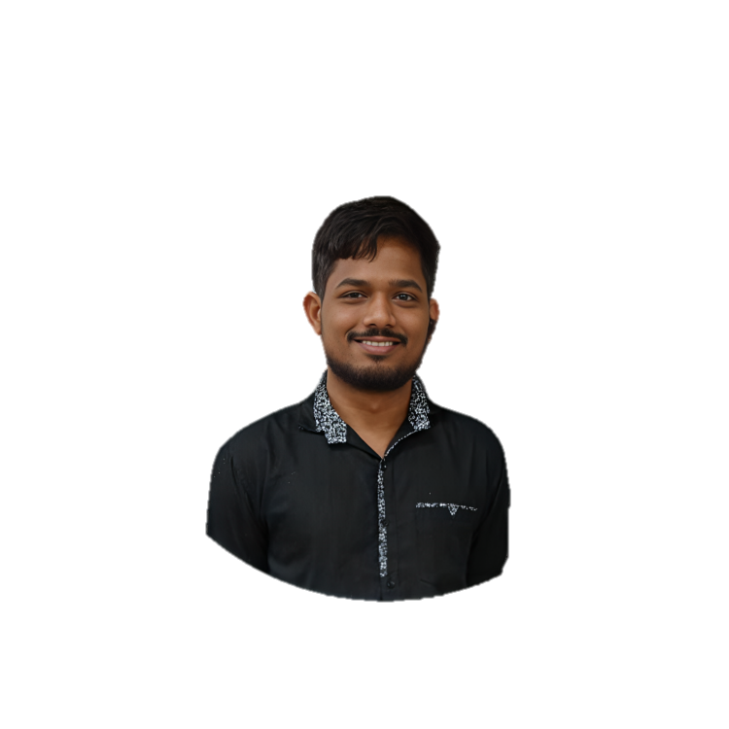



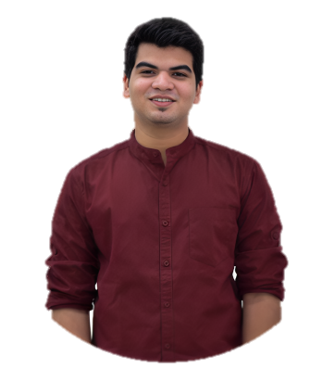
Centre of Entrepreneurship & Innovation (COEI)
Successful Startups
Success Stories
Rcube Recycling Pvt. Ltd. won seed funding of Rs. 5 lakhs from AICTE & MoE. and Rs. 22 Lakhs from Ministry of Housing and Urban Affairs (MOHUA) and announcement of Rs. 52 Lakhs from Gujarat Government.
Betinal Pvt. Ltd. raised pre-seed funding of Rs. 10 lakhs from angel investors.
Infobucket Technoplex LLP.
raised seed funding of Rs. 5 lakhs from angel investors.

